Slide 1


Employee Management System
By Ayushi Paliwal

Slide 2


Ayushi Paliwal
Introduction
Technology Integration Engineer
Ayushi.Paliwal@amdocs.com
Contact :- 9828831396
I am a Technology Engineer at Amdocs, with a passion for dancing, bike riding, and music. I hold a B.Tech degree in Computer Science, which has been instrumental in shaping my career in technology and engineering.
Mentor
Sachin Vasav
Amdocs

Slide 3

Today’s Agenda
01
Introductions
04
Database Connectivity
02
Purpose of Project
05
Key Functionalities
06
Conclusion and Feedback
Amdocs
03
Technology Used

Slide 4




What
Why
These systems facilitate the management of employee information, including recruitment, performance tracking, and payroll processing, through a centralized platform.
Employee Management Systems are essential for streamlining HR processes, improving data accuracy, and enhancing employee engagement within organization
Where
When
Employee Management Systems are typically implemented in corporate offices, HR departments, and remote work environments to manage workforce data effectively.
The adoption of great importance in today's technology landscape, Python serves as a versatile programming language, while MySQL is a powerful database management system.
Amdocs

Slide 5

Importance of Efficient Data Management
01
03
02
Streamlined Operations
Data Accuracy and Integrity
Efficient data management ensures that employee records are accurate and up-to-date, reducing errors that can lead to compliance issues and financial discrepancies.
An effective data management system minimizes redundancy and improves workflow efficiency, allowing HR teams to focus on strategic initiatives rather than administrative tasks.
Enhanced Decision-Making
With organized data, management can make informed decisions regarding workforce planning, performance evaluations, and resource allocation, ultimately driving organizational success.
Amdocs

Slide 6





Technologies Used in this Project

Slide 7
Packages installed for Database Connectivity
mysql.connector
mysql.connector.python
mysqlclient
mysql -u root -p
ALTER USER ‘root'@'localhost' IDENTIFIED WITH mysql_native_password BY ‘root';
Amdocs
Flush Privileges;
default-authentication-plugin = mysql_native_password

Slide 8


Key Functionalities of Employee Management System
Add Employee Details
View Employee Details
Sort Employee Details
Calculate Tenure
Update Employee Details
Search Employee Details
View Employee Details By ID
View Salary Distribution
Amdocs
Delete Employee Details
Filter by Salary
Department Summary
Exit

Slide 9
Action To be Taken
Action 1
Functionality: Users can register with a unique username and password.
Data Collected: Username, password, phone, email, location, department.
Error Handling: Matching password check, error messages for duplicate usernames.
Action 2
Functionality: Users can log in to access employee management features.
Validation: Check against the database for valid credentials.
Error Messages: Handle invalid login attempts.
After registration use username and password to login
Amdocs

Slide 10
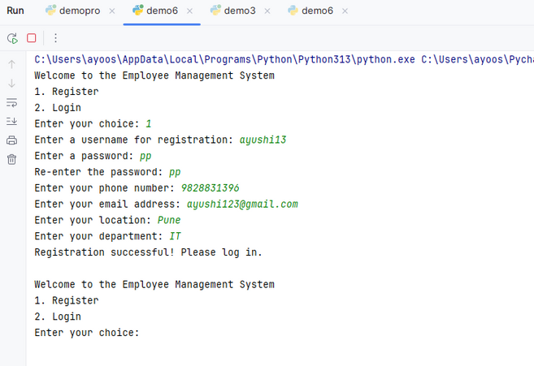
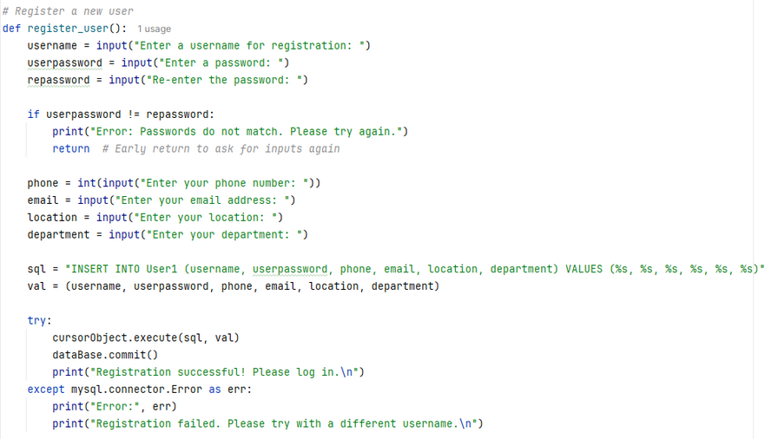
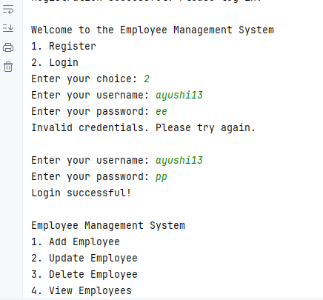
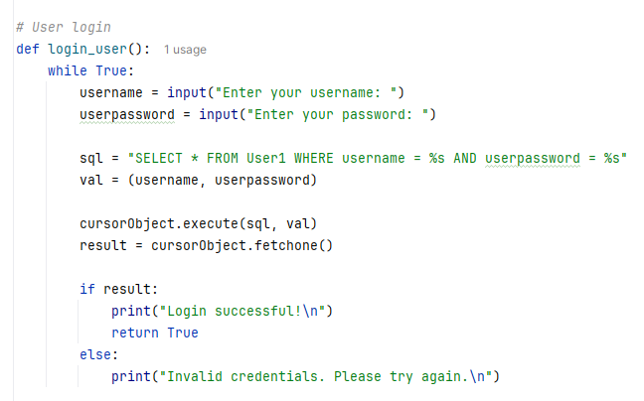
Output
Code Snippet to register
Output
Code Snippet to Login
Amdocs

Slide 11

Adding and Updating Employees
Deleting and Viewing Employees
Searching and Filtering Employees
Add Employee: Captures details (ID, name, email, etc.) and inserts into the database.
Update Employee: Modifies existing records based on employee ID.
SQL Commands Used: INSERT, UPDATE.
Delete Employee: Removes employee records by ID.
View Employees: Displays all employee records in a list.
SQL Commands Used: DELETE, SELECT.
Search Employee: Finds records by name, email, designation, or department.
Filter by Salary: Retrieves employees within a specified salary range.
SQL Queries Used: SELECT ... WHERE with LIKE, BETWEEN.
Sorting and Viewing Employee Details
Department Summary and Tenure Calculation
Salary Distribution
Functionality: Breaks down total salary into base salary, PF, HRA, and income tax.
Formulas Used:
Base Salary = Total Salary * 40%
PF = Total Salary * 24%
HRA = Base Salary
Income Tax = Base Salary * 8.33%
Department Summary: Counts employees in each department.
Calculate Tenure: Calculates how long an employee has been with the company based on the hire date.
SQL Commands Used: GROUP BY, date calculations.
Sort Employees: Users can sort records by empid, name, salary, or hiredate.
View Employee Details: Detailed view of a specific employee by ID.
SQL Commands Used: ORDER BY, SELECT.
.
Amdocs

Slide 12
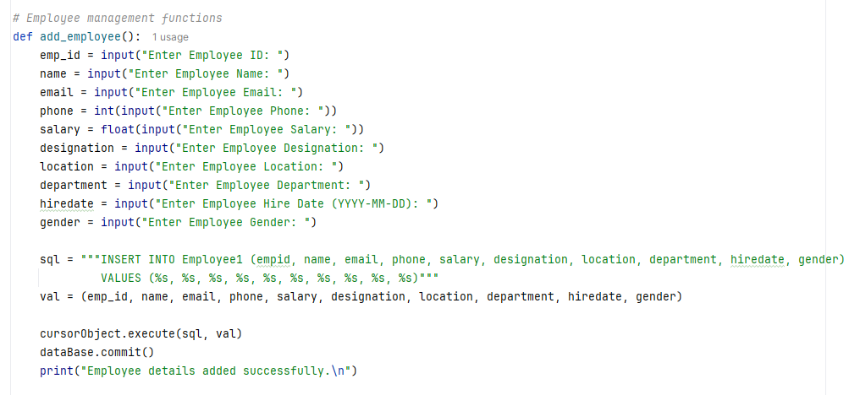

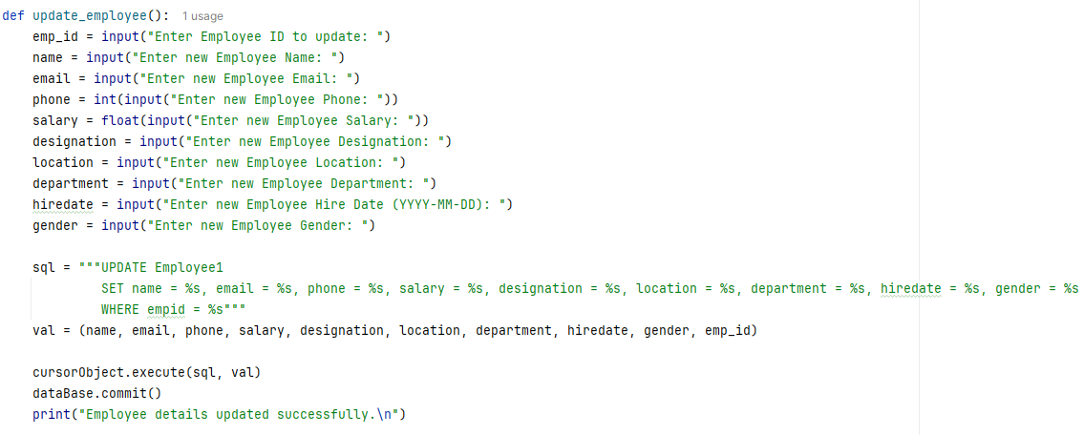
Code Snippet for add_employee()
Code Snippet for update_ employee()

Slide 13
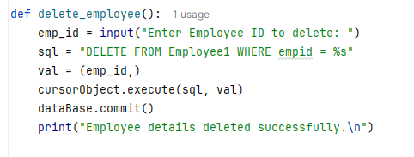
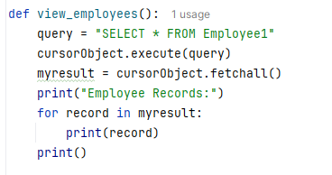
Code Snippet for delete_employee()
Code Snippet for view_ employee()

Slide 14
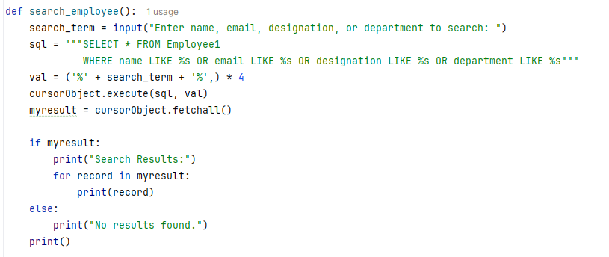
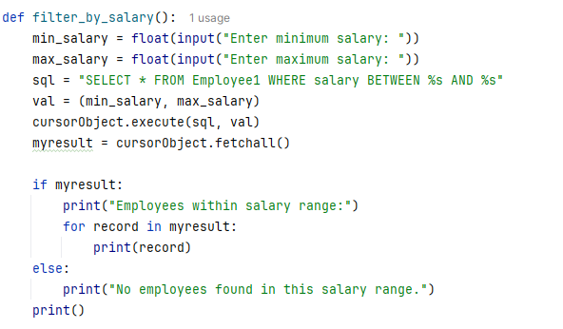
Code Snippet for search_employee()
Code Snippet for filter_by_salary()

Slide 15
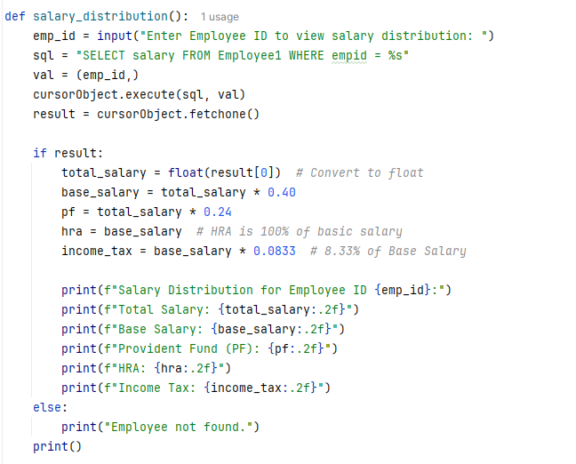
Code Snippet for salary_distribution()

Slide 16




Give your Feedback
https://forms.gle/FGvq1LYP3tESEv8R9
Ayushi.Paliwal@amdocs.com
9828831396

Slide 17


Thank You!

